Slide 1
Course Code:CSC402A Course Title: Web Architecture and Application Development
Course Leader:
Kishore S.M.
kishore.cs.et@msruas.ac.in

Slide 2
Objectives
At the end of the lecture, students will be able to
Analyze software structures and software elements
Describe web architecture

Slide 3
Contents
Software structures and software elements
Introduction to web architecture

Slide 4
Software Structures
Software Runtime structure
At runtime a project consists of one or more threads, processes, functional units, and data units. These elements may run on the same computer or on multiple computers across a network. The same element in a code structure may implement or support multiple runtime elements
For example, in a client-server application, the same client module may run on many client computers. Conversely, several code structure elements may implement or support a single runtime element
For example, many threads will run multiple methods from different classes that maybe packaged in different code units

Slide 5
Software Structures
The connectors at this level inherit attributes from their source-code structure counterparts, along with the following other attributes:
Multiplicity: One element can be connected to multiple elements if it needs to invoke methods of multiple elements at runtime
Distance and connection media: Two connected elements may communicate in the same thread, in the same process, on the same computer, or on different computers across a network. Based on the distance between two elements, the communication media may vary from copper/optical cable or wireless based LAN to the Internet.
Universally Invocable: A connector with this attribute set to true allows any external software system

Slide 6
Software Structures
Self-descriptive: A connector with this attribute set to true can allow an external software system to invoke its target method without the pre-installation of any software specific to the method

Slide 7
Software Structures
Software Management structure
A large software project is normally designed and implemented by several project teams, each having its well-defined responsibilities at specific SDLC process stages
Software runtime structures serve as the technical backbone of architecture designs and provide the basis from which other structures are derived

Slide 8
Software Elements
At runtime each software element has well-defined functions and connects to the other elements into a dependency graph through connectors
The elements of a software architecture are usually refined through multiple transformation steps based on their attributes and the project requirement specifications.
Depending on each software element's assigned function, there may be different synchronization and performance constraints

Slide 9
Software Elements
There are some basic guidelines for mapping runtime elements into their implementations:
If an element is reentrant
If an element is not reentrant and multiple threads or processes need to communicate with it
If the elements contain heavy computations for deployment at a particular location
If an element is assigned complex but well-defined functions
A complex element can be expanded into a subsystem with its own elements and connectors
A complex element can be transformed into a sequence of vertical layered elements
A complex element can be transformed into a sequence of horizontally tiered elements

Slide 10
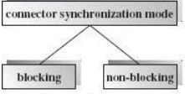
Software Connectors
A software connector indicates the necessity during system execution for one of the elements to send a message to another element and potentially get a return message
Based on the connector's synchronization mode, we can classify all connectors into two categories: blocking connectors and non-blocking connectors

Slide 11
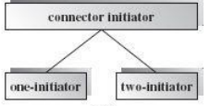
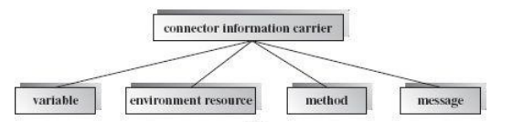
Software Connectors
Based on the connector's initiator, we can classify all connectors into two categories: one-initiator connectors and two-initiator connectors
The information flow on a connector can be implemented using various information carriers

Slide 12
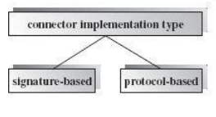
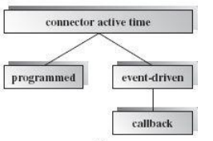
Software Connectors
Based on the implementation type, a connector may be classified as signature-based or protocol-based
Connector active time refers to when an operation request or message is sent over a connector. Connectors may be classified into programmed connectors and event-driven connectors

Slide 13
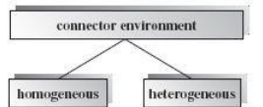
Software Connectors
Based on connector environment, which is the implementation technology or supporting platforms of a connector's two incident elements, we classify connectors into homogeneous connectors and heterogeneous connectors

Slide 14
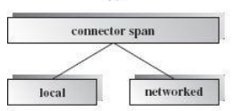
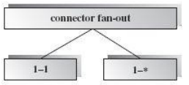
Software Connectors
Based on the connector span between incident elements, we classify the connectors as local connectors or networked connectors
Based on connector fan-out (the number of elements one element can connect to) we classify connectors as 1-1 connectors and 1-* connectors

Slide 15
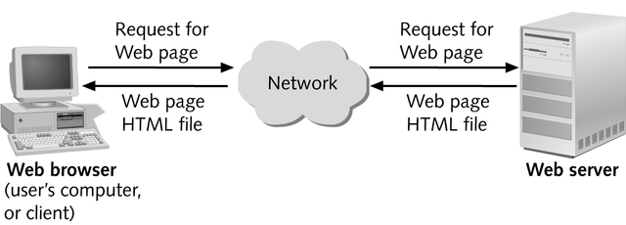
Introduction to Web Architecture
In 1989, Tim Berners-Lee had suggested a way to let all users, but particularly scientists, browse each others’ papers on the Internet
He developed HTML, URLs, and HTTP
The web is a two-tiered architecture
A web browser displays information content and a web server that transfers information to the client

Slide 16
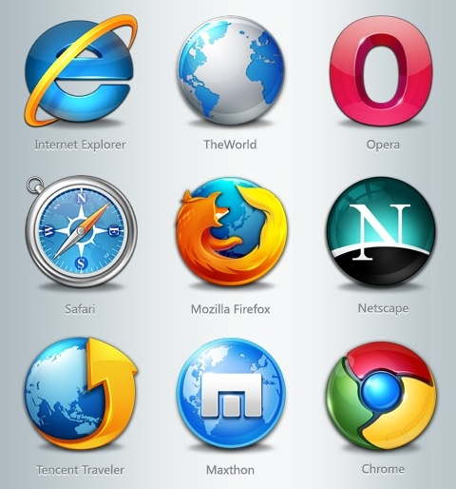
Introduction to Web Architecture
Web Browser
The primary purpose is to bring information resources to the user
An application for retrieving, presenting, and traversing information resources

Slide 17


Introduction to Web Architecture
Web Server
The term web server can mean one of two things:
A computer program that accepts HTTP requests and return HTTP responses with optional data content
A computer that runs a computer program as described above

Slide 18
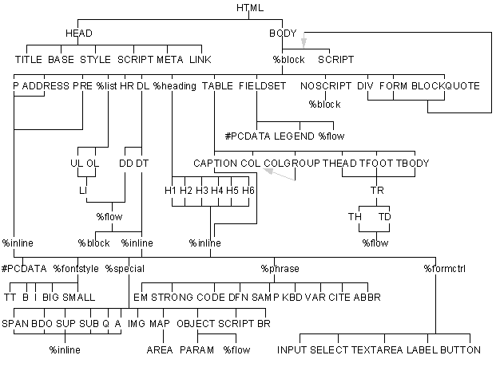
Introduction to Web Architecture
HTML
Document layout language (not a programming language)
Defines structure and appearance of Web pages

Slide 19
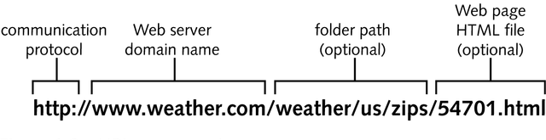
Introduction to Web Architecture
URI (Universal Resource Identifier)
URLs are location dependent
It contains four distinct parts: the protocol type, the machine name, the directory path and the file name.
There are several kinds of URLs: file URLs, FTP URLs, and HTTP URLs.

Slide 20
Introduction to Web Architecture
HTTP (HyperText Transfer Protocol)
HTTP is a request/response standard of a client and a server.
Typically, an HTTP client initiates a request.
Resources to be accessed by HTTP are identified using Uniform Resource Identifiers (URIs).
Request Methods
HTTP defines eight methods (sometimes referred to as "verbs") indicating the desired action to be performed on the identified resource.
-HEAD -TRACE
-GET -OPTIONS
-POST -CONNECT
-PUT
-DELETE

Slide 21
Summary
A large software project is normally designed and implemented by several project teams
A software connector indicates the necessity during system execution for one of the elements to send a message to another element and potentially get a return message

